Slide 1

Traffic Signal Management & Control System: Optimising Flow
Team Members:
Sai Khushee (230701276) Shankaranarayanan (230701306) Sentamizh (230701301)

Slide 2
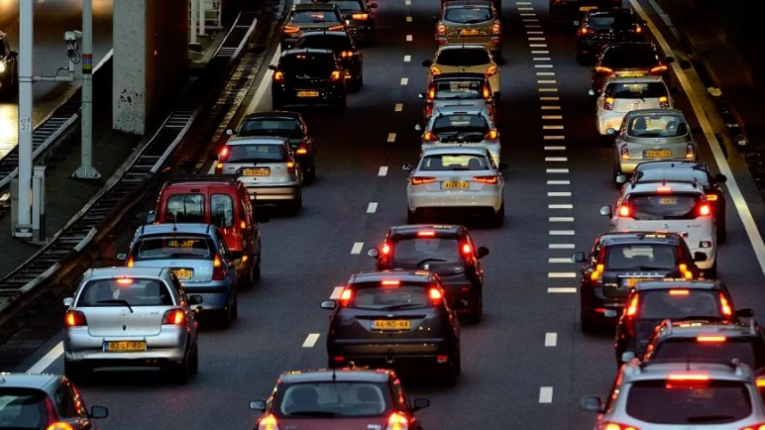
Abstract:
This IoT-based Traffic Signal Management and Control System optimises urban traffic flow and enhances emergency response. Infrared sensors detect vehicle density, adjusting signal timings to favour busy lanes and skip empty ones, reducing congestion. In emergencies, ambulances/fire trucks get instant green light priority. This smart system ensures smoother traffic, prioritises emergency vehicles, saves energy, and contributes to a more efficient and sustainable urban traffic.

Slide 3

Introduction
With the rapid increase in the number of vehicles, urban regions are facing significant difficulties in managing traffic effectively. Conventional traffic signal systems rely on predetermined timing cycles that do not respond to actual traffic conditions, resulting in poor traffic management, longer delays, and inconvenience for daily commuters.
1
2
The impact is even more severe for emergency vehicles, which frequently get stuck in traffic despite the urgency of their missions. A modern traffic control system is crucial to overcome these challenges. By deploying IR sensors at strategic points in each lane, the system can continuously monitor vehicle flow and adjust signal durations based on real-time traffic conditions.
This adaptive control helps reduce congestion and improves traffic efficiency. Furthermore, the use of RFID technology enables the system to identify emergency vehicles through RFID tags, granting them immediate right of way by turning their lane's signal green. This not only enhances emergency response times but also contributes to safer and smarter urban mobility.
3

Slide 4





Objective
Automate traffic signal control using IR sensors
Implement infrared sensors to detect the real-time density of vehicles on each lane, enabling dynamic and adaptive traffic signal timing that responds to actual traffic conditions rather than fixed intervals.
Prioritise emergency vehicles through RFID detection
Use RFID technology to identify approaching emergency vehicles, allowing the traffic signals to automatically turn green for these lanes, reducing their response times and enhancing safety.
Reduce idle waiting time and improve traffic flow efficiency
Minimise unnecessary red light time for lanes with little to no traffic by skipping cycles, thus reducing overall congestion and improving commute times for regular traffic.
Provide a cost-effective and scalable IoT solution
Design a traffic management system that is affordable for widespread deployment and can be easily scaled or upgraded, incorporating IoT devices for continuous monitoring and control.

Slide 5

Existing System:
In the existing traffic management systems, traffic lights operate on a fixed timing mechanism. The signal changes are based on predetermined time intervals regardless of the actual number of vehicles waiting at each lane. Traffic police may manually control the lights during peak hours or special situations, but this process is inefficient, labor-intensive, and prone to human error. Additionally, emergency vehicles often struggle to navigate through traffic as there is no automated mechanism to detect their presence and adjust traffic signals accordingly. Delays in emergency services can result in severe consequences, especially in medical emergencies, fire accidents, and police interventions.

Slide 6

Proposed System:
The proposed system utilises two IR sensors per lane to estimate vehicle density. If both IR sensors in a lane detect vehicles, it indicates high traffic, prompting the microcontroller to increase the green light duration for that specific lane. This allows more vehicles to pass through and reduces congestion effectively.
To handle emergency vehicles, each is fitted with an RFID tag. An RFID reader installed near the intersection detects the tag as the vehicle approaches. Upon recognizing a valid emergency RFID, the traffic light for that lane immediately turns green, regardless of its previous state. This ensures emergency vehicles get the right of way without delay.
The system is controlled using a microcontroller (like ESP32 or Arduino), and the logic is coded to manage the traffic lights based onsensor input. The entire process is automatic and requires minimal human intervention, leading to efficient and intelligent traffic control.

Slide 7





Modules Used
Vehicle Detection Module
Equipped with 8 IR sensors (2 per lane) to detect short and long vehicle queues.
Emergency Vehicle Detection
Uses RFID reader and tags to identify emergency vehicles promptly.
Control Module
ESP32 microcontroller makes decisions and controls the traffic signals automatically.
Output Module
LEDs simulate traffic lights for each lane, displaying the control outputs visually.

Slide 8
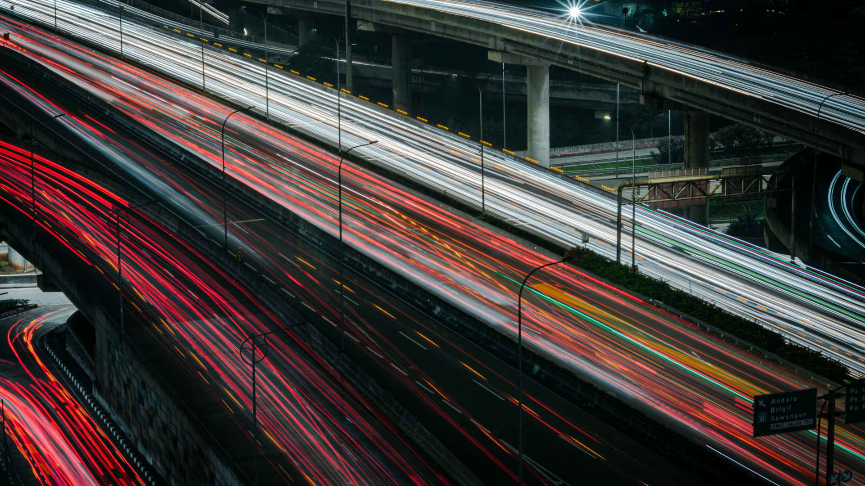
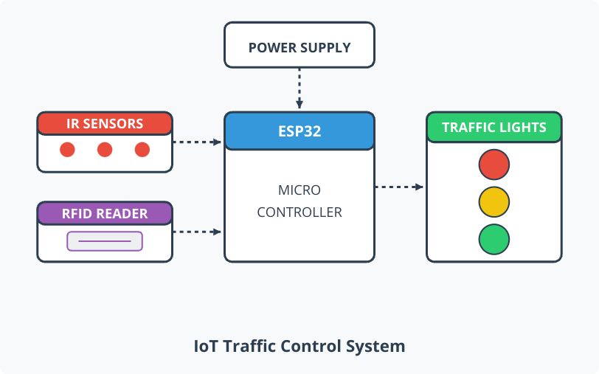
Block Diagram
This block diagram illustrates an ESP32-based smart traffic control system. The microcontroller interfaces with IR sensors for vehicle detection and an RFID reader for authorised vehicle identification.
Based on these inputs, the ESP32 processes the data and controls traffic lights to optimise traffic flow. The entire system is powered by a dedicated power supply unit, creating a complete IoT solution for intelligent traffic management.

Slide 9

Advantages
Real-time traffic detection
Dynamic signal timing
IR sensors enhance traffic efficiency.
Improves vehicle flow and reduces wait times.
Priority for emergency vehicles
Minimal human intervention
RFID ensures quick and safe passage.
Reduces errors and increases reliability.
Energy-efficient and cost-effective
Scalable and adaptable
Lower energy use and implementation costs.
Ready for future smart city integration.
Reduces fuel consumption and pollution
Improves emergency response time
Less idle time cuts emissions.
Potentially saves lives in critical moments.

Slide 10

Future Enhancements
Replace IR with more robust sensors: Upgrade the vehicle detection module by using ultrasonic sensors or high-resolution cameras to increase accuracy and reliability under various weather and lighting conditions.
Integrate GSM or IoT cloud for central monitoring: Enable real-time remote access and control through GSM networks or cloud platforms to facilitate centralised traffic management and quicker response to incidents.
Solar-powered traffic units: Implement solar panels to power traffic signal units, promoting energy efficiency and sustainability, especially in areas with limited electrical infrastructure.
ML-based traffic prediction for smarter scheduling: Use machine learning algorithms to analyze traffic patterns over time, allowing predictive adjustments to signal timings that can reduce congestion significantly.
Mobile app interface for real-time traffic status: Develop a user-friendly mobile app that provides commuters with live updates on traffic conditions, estimated wait times, and alerts to make informed travel decisions.

Slide 11

Conclusion
The intelligent traffic light management system proposed in this project offers a practical and effective solution to urban traffic problems. By using IR sensors for traffic density detection and RFID for emergency vehicle prioritization, the system ensures smoother traffic flow and faster emergency response times. It eliminates the drawbacks of traditional fixed-time traffic signals and manual interventions. This project presents a scalable, low-cost, and efficient solution that can play a significant role in the development of smart transportation infrastructure in modern cities.

